Slide 1


IBM Skills Build
09/05/2024
Group 13

Slide 2
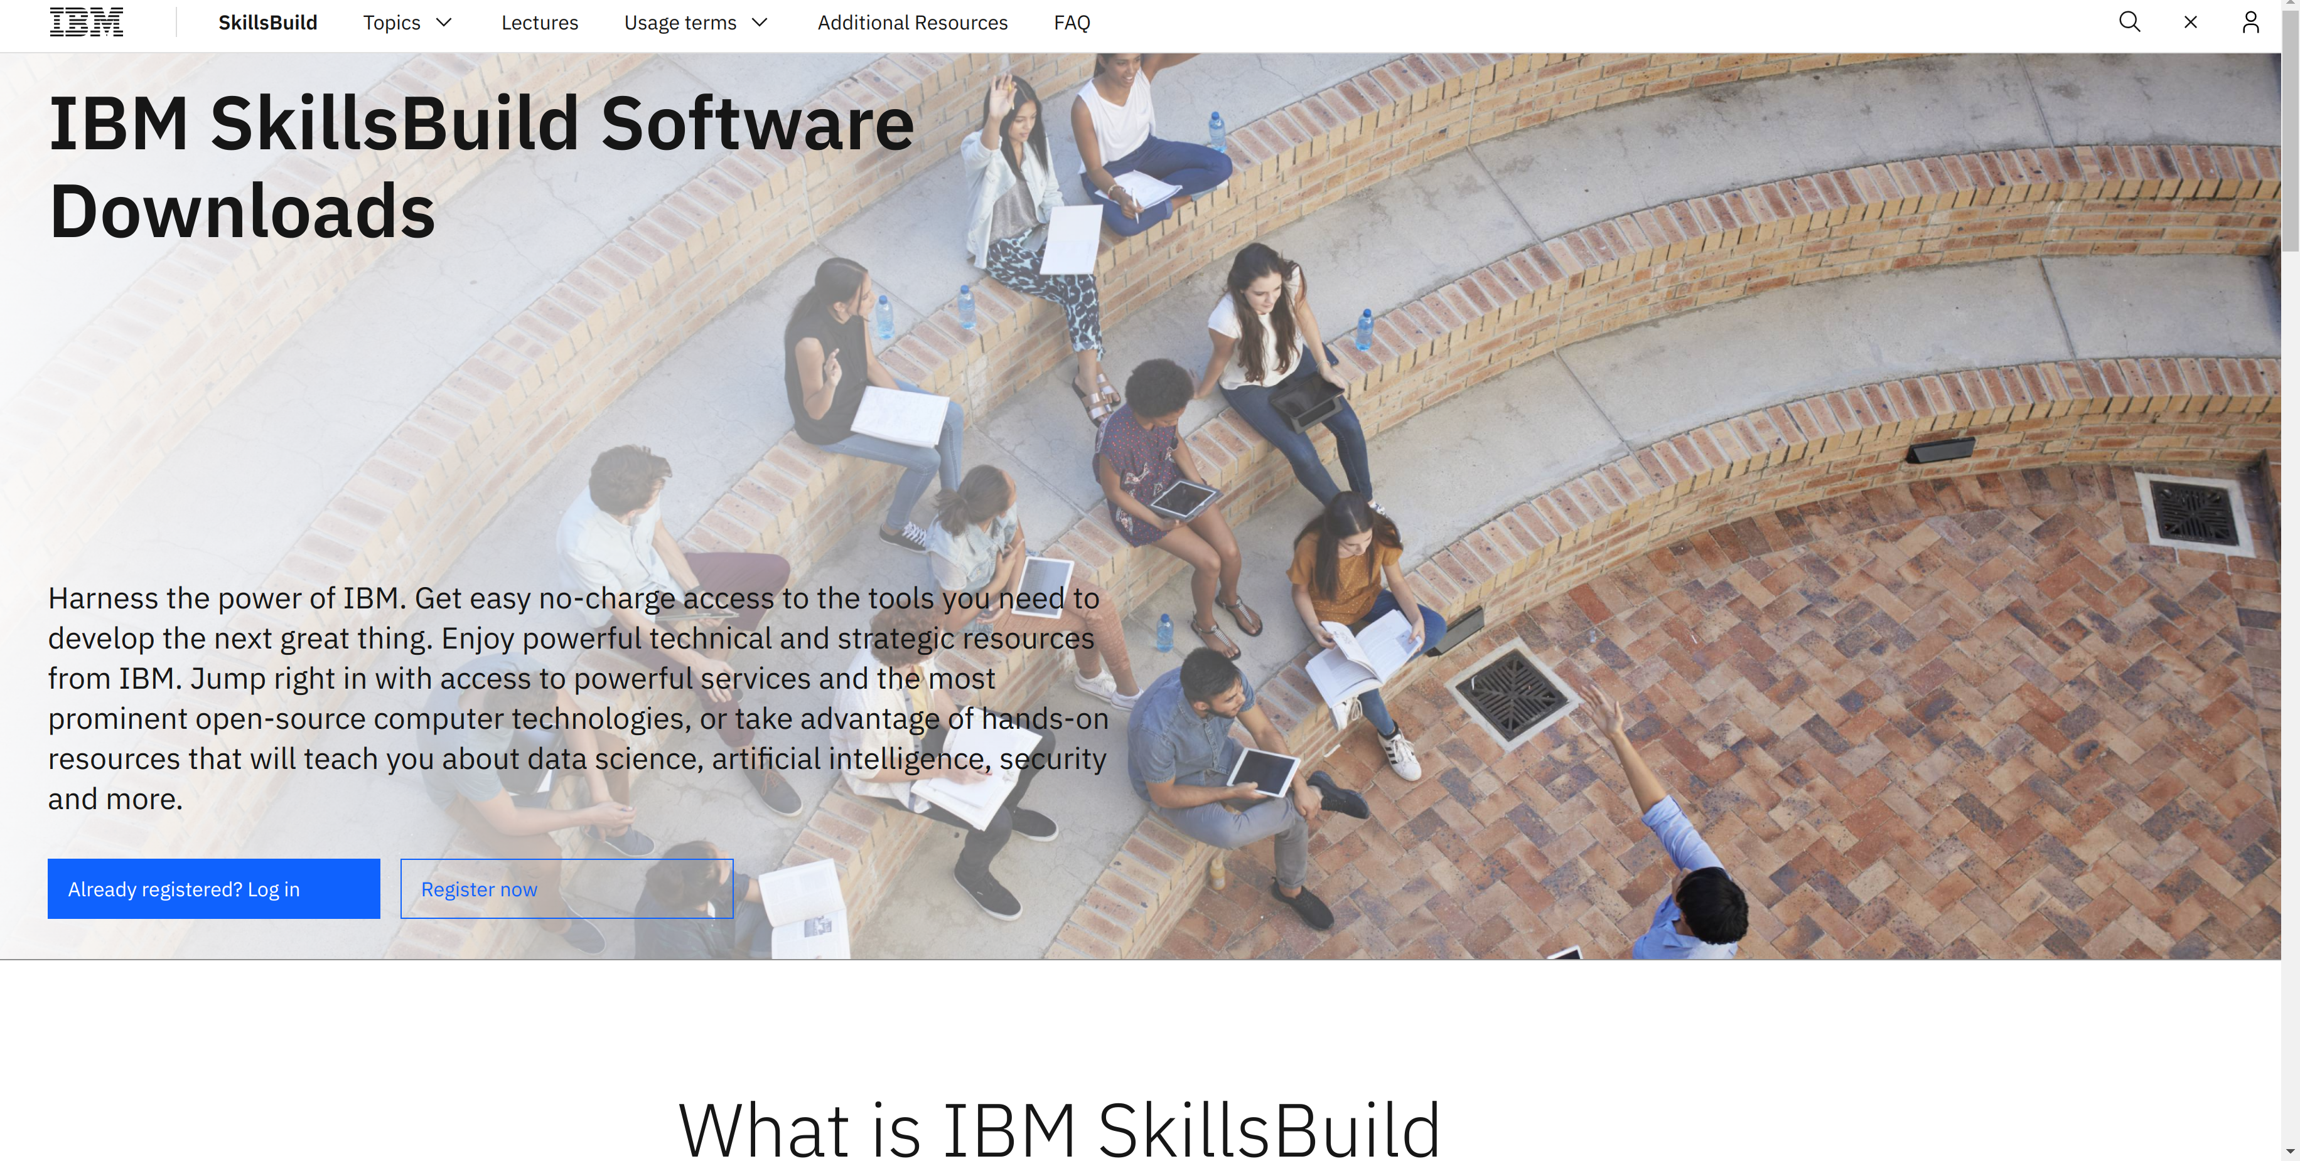
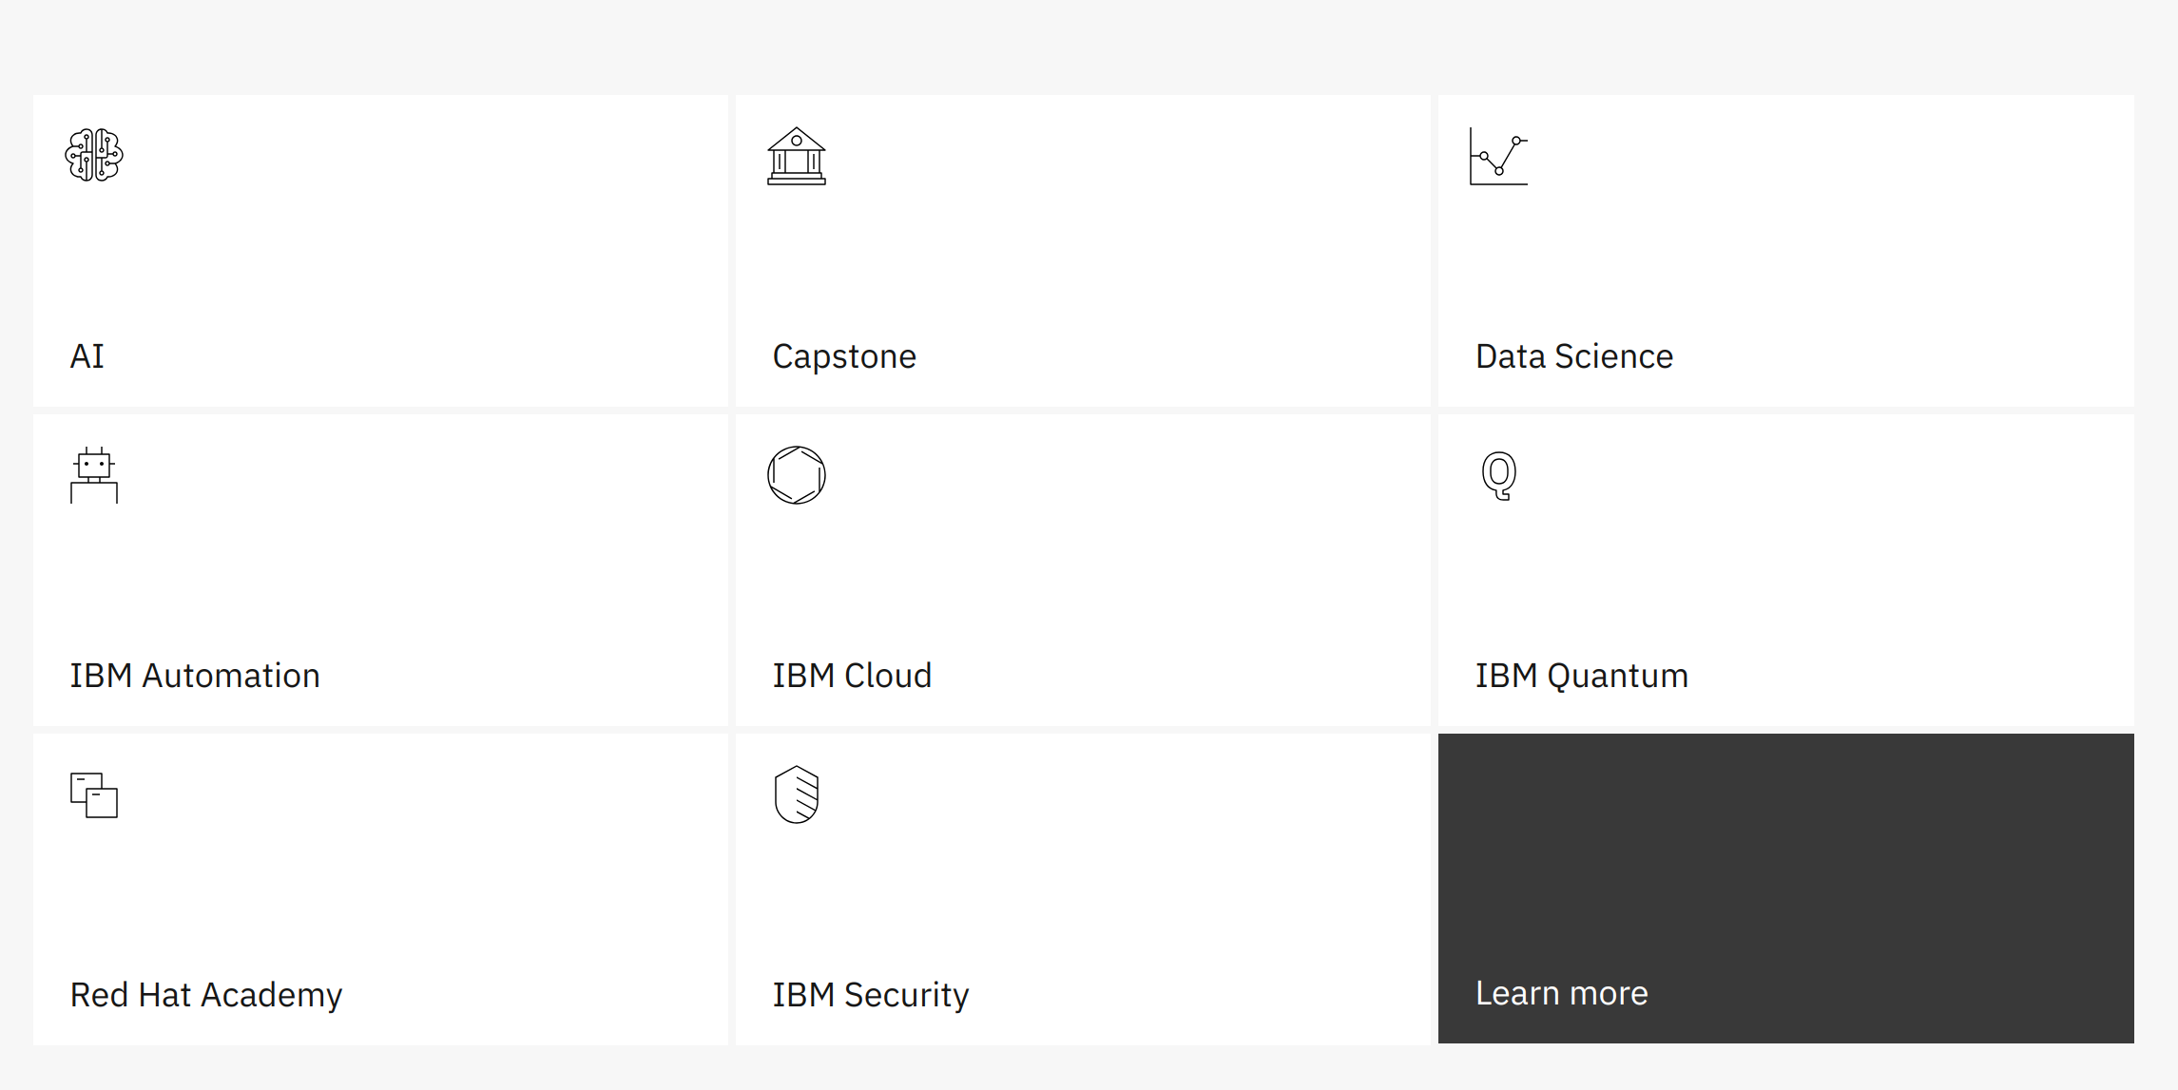
Context
IBM Skills Build program: Established in 2005 as the IBM Academic Initiative.
Educational platform that provides free access to digital skills and training on topics such as: AI, IBM Cloud, Data Science, etc.
"We're skilling 30 million people globally by 2030"
www.skillsbuild.org/

Slide 3

Initial Tasks
Predict the trend of increased skills gap (specific skills).
Identify current shortfalls in needed specific skills.
Recommendations for IBM's content.

Slide 4

Initial Process (First plan):
Employer Skills
Survey – UK Gov.
Feature Engineering
EDA and Data Wrangling
Modelling: Time Series- Skill Gap
Evaluate results and make recommendations
Final Report
Other datasets / articles

Slide 5

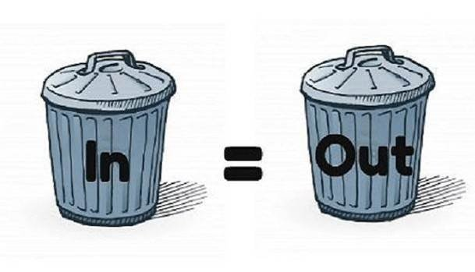
But...

Slide 6
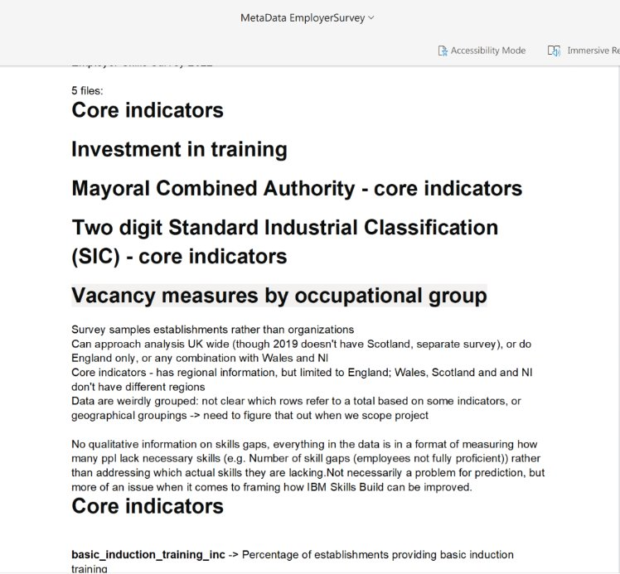
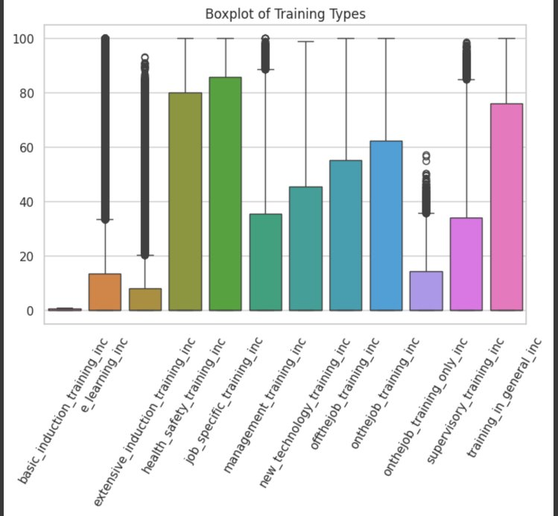
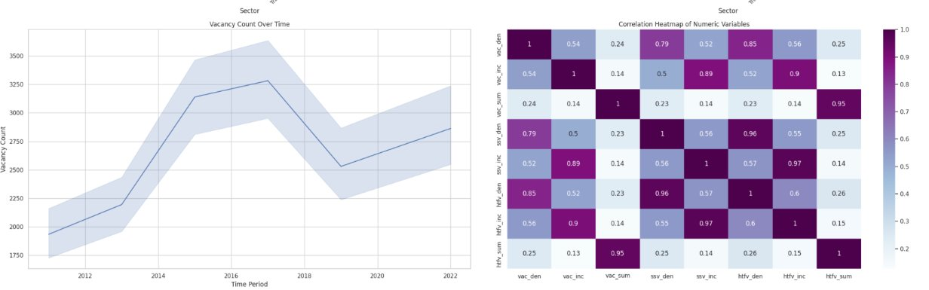
Main problems on the original dataset:
More than 90% of the records were missing or confidential/restricted values
No information about gaps in specific skills
Change in the methodology of the survey: questions/industries/regions over the years
EDA – Employee Survey

Slide 7
So we started searching, looking for answers, new datasets/ideas...

Slide 8
Labour Demand Analysis

Slide 9

Labour demand (New Ads - Dataset)
Characteristics:
Monthly new job ads by SOC2 (Region) and SOC4 (Country)
Data scrape (Gov) from approx. 90,000 job boards and recruitment pages
Opportunities:
Data shows employers that couldn't find the right skills for some roles in their companies.
Data shows which roles employers are opening for the public.
Good level of Granularity --> SOC4 (Country) and SOC2 (Regions)
Objectives with this New Ads dataset:
Obtain Occupational Demand by 2025 – Forecasting SOC4 granularity and SOC2 by Region
Select the SOC4 most important for IBM – Growing trend and size of market
Obtain Regional Skill Gaps for chosen SOC4 in 2025
Input for scraping: Getting the skills that the market is currently looking for.

Slide 10
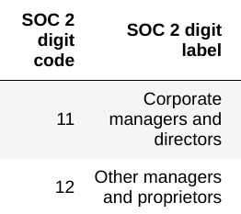

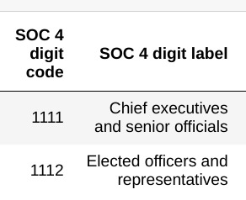
SOC 2 and SOC 4:
SOC2 (Family)
Standard Occupational Classification:
SOC-4 indicates classification by 4-digit code, which is the most granular level. SOC-2 indicates classification by 2-digit code.
SOC4

Slide 11
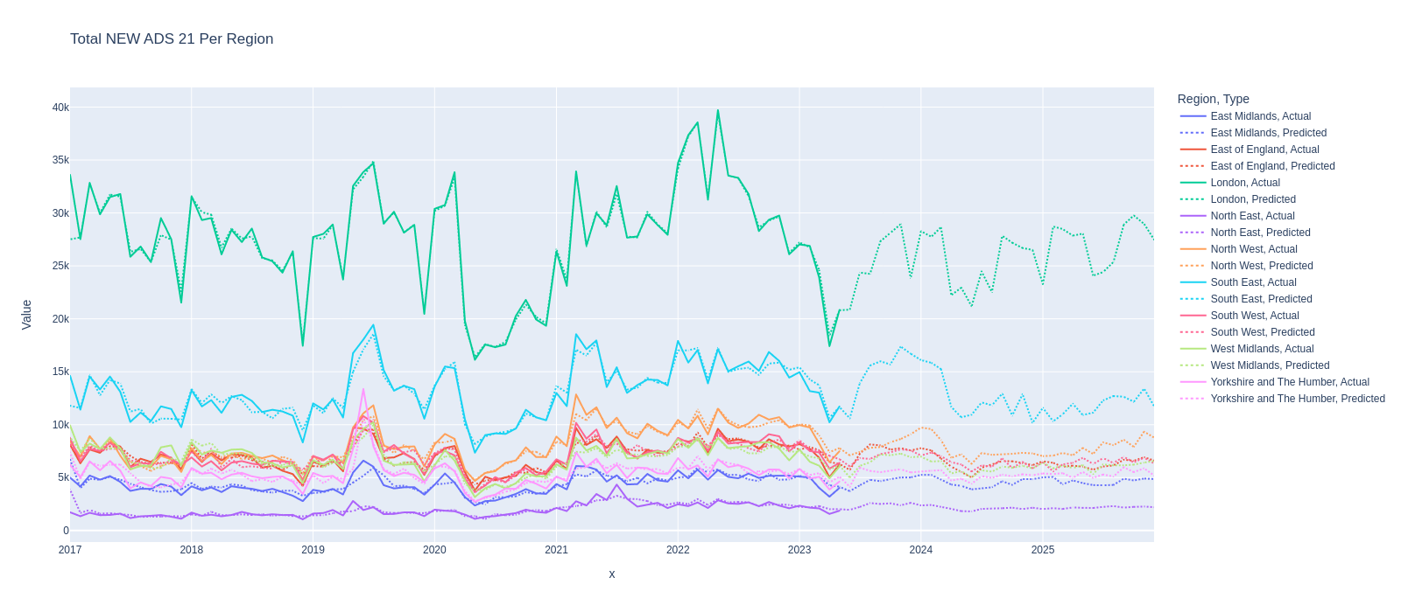
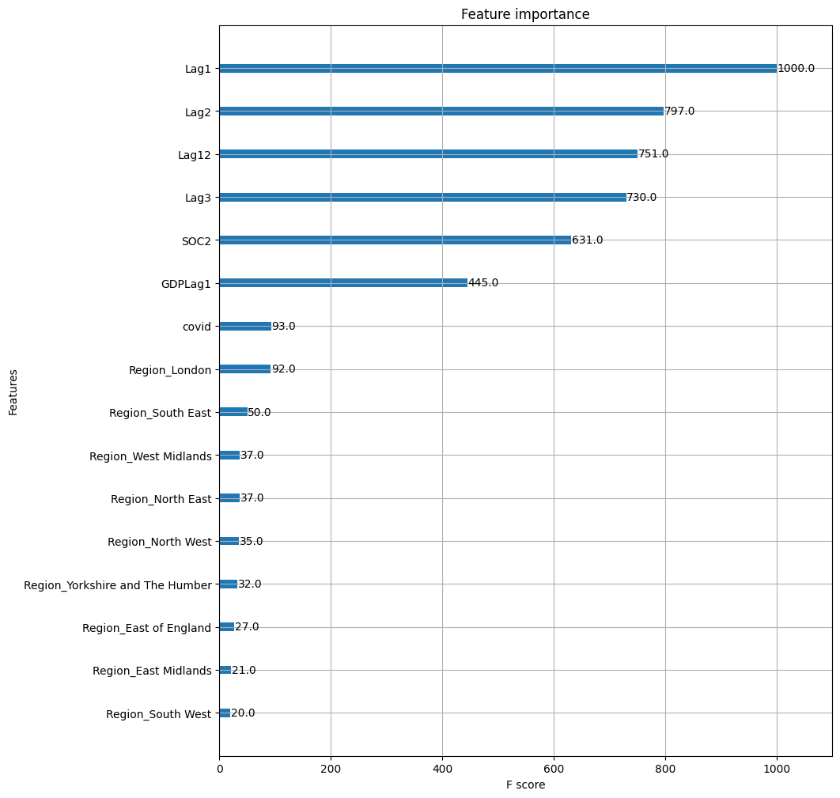
XGBoost - Labour demand Forecast – 2025 by SOC2
Example: SOC21--> Science, research, engineering and technology professionals
Error type | Evaluation: RMSE
Training Error | 0.104
Validation Error | 0.248

Slide 12
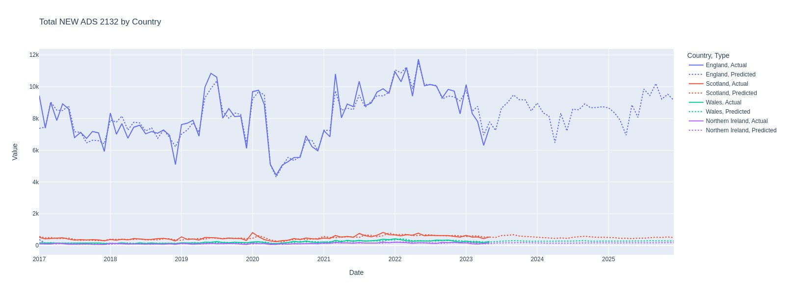
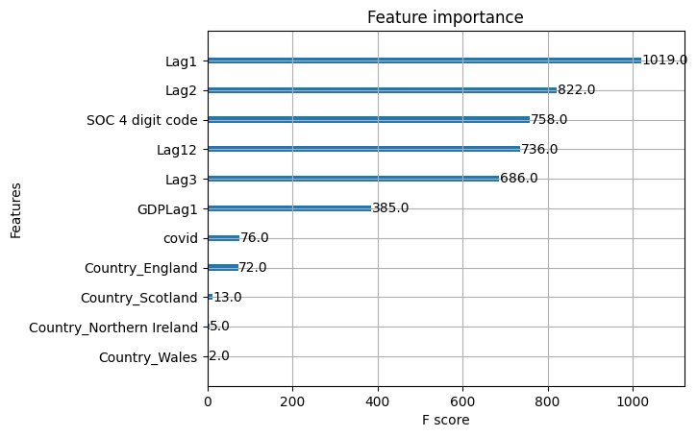
XGBoost - Labour demand Forecast – 2025 by SOC4
Example: SOC2132 -> IT Managers
Error type | Evaluation: RMSE
Training Error | 0.43
Validation Error | 0.48

Slide 13
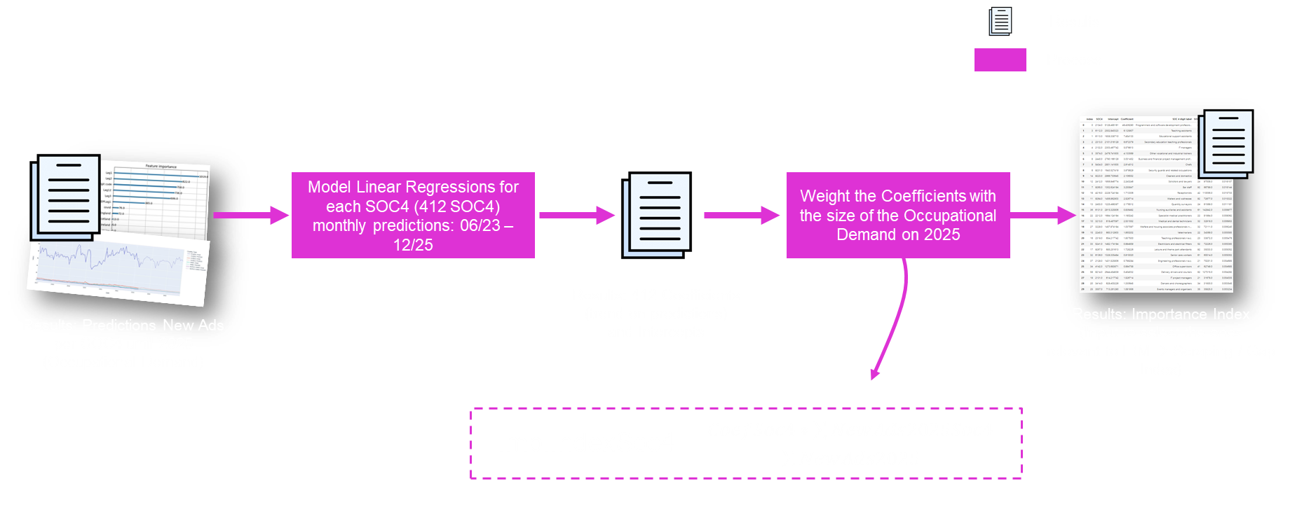
Importance Index
🎉 Results: Top 4 most important SOC4 for partner
Programmers and software development professionals - SOC2134
IT Managers - SOC2132
Business and financial project management professionals - SOC2440
IT project managers - SOC2131

Slide 14
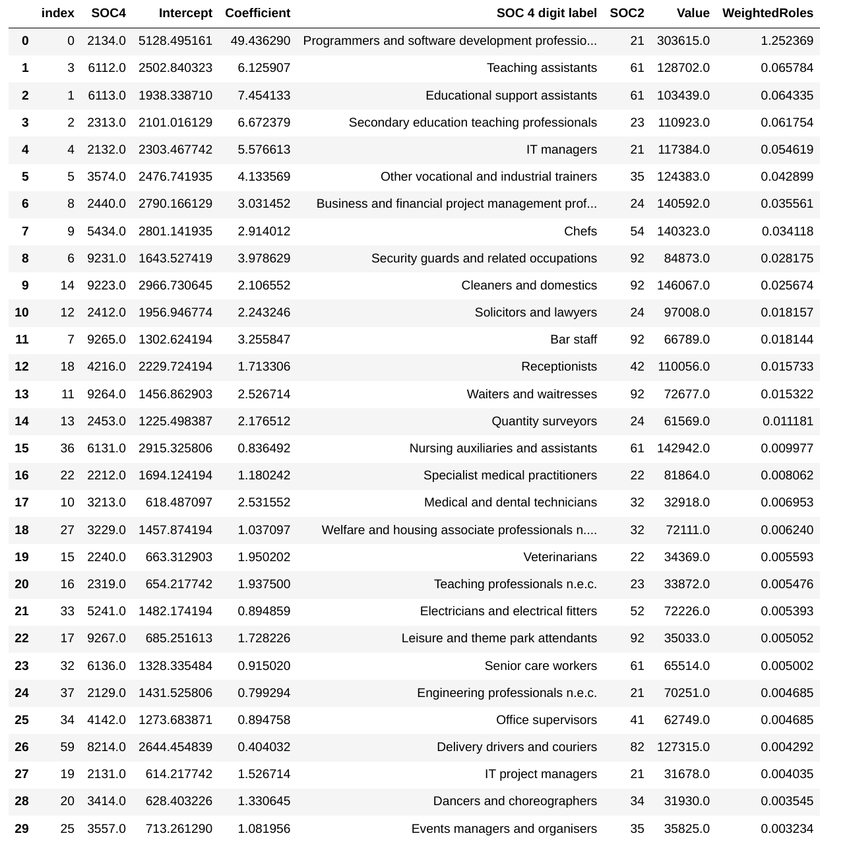
Importance Index - Table
Selected SOC4 for IBM

Slide 15
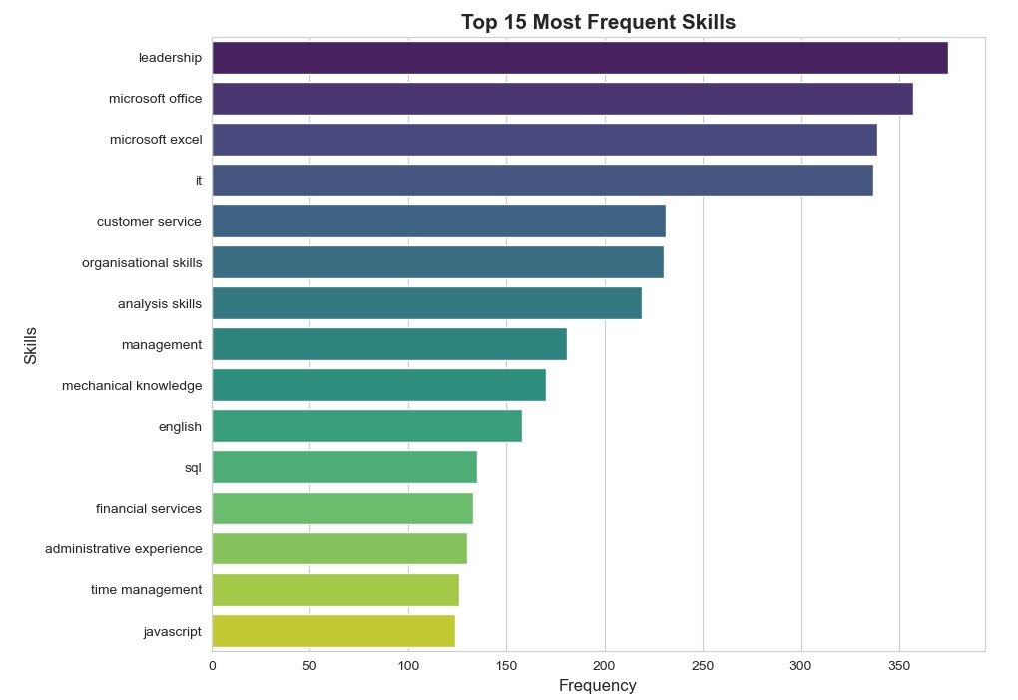
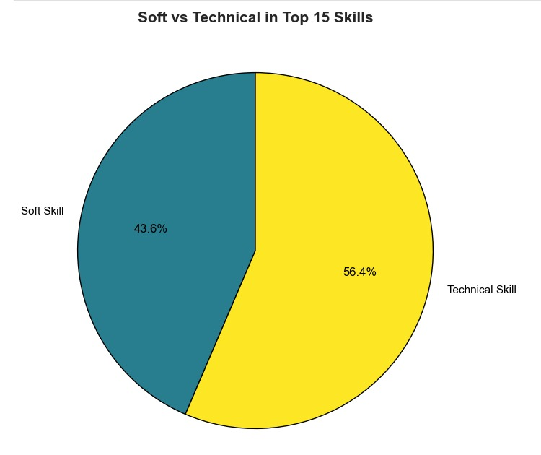
Scraping: Most Prevalent Skills ( >14,000 Posts)

Slide 16
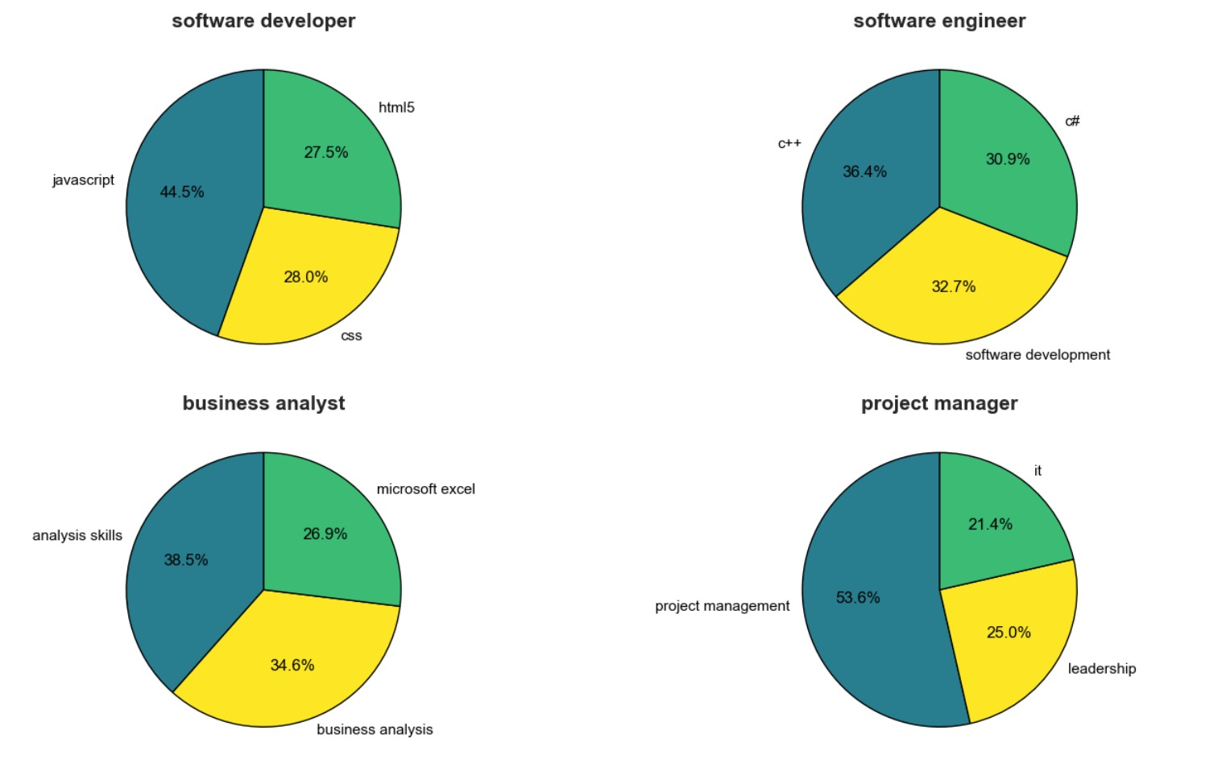
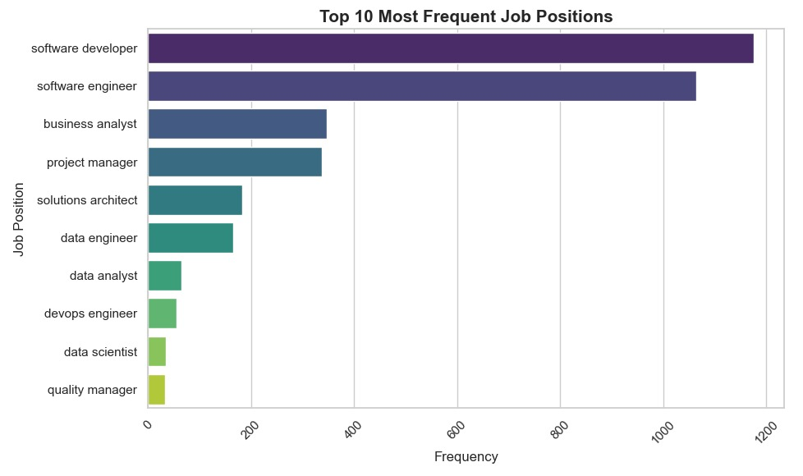
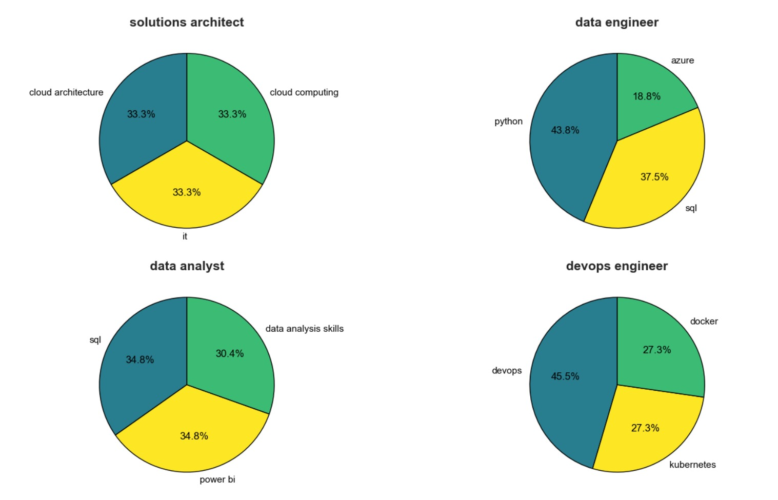
Scraping: Skills by Postings

Slide 17
Scraping: Key Takeaways
Over 14,000+ unique job postings scraped and analyzed
Overwhelming need for basic and advanced IT skills, and literacy
Strong desire for soft skills across all levels, from Juniors to Managers
Soft skills on par with Technical skills in terms of market requirements
Despite the skill overlap between postings, each Tech Stack still requires expertise in different specific programming languages or frameworks
Emerging new positions and skills (NLP, GenAI, xAI)

Slide 18

Regional GAP Index - Regional GAP Importance

Slide 19
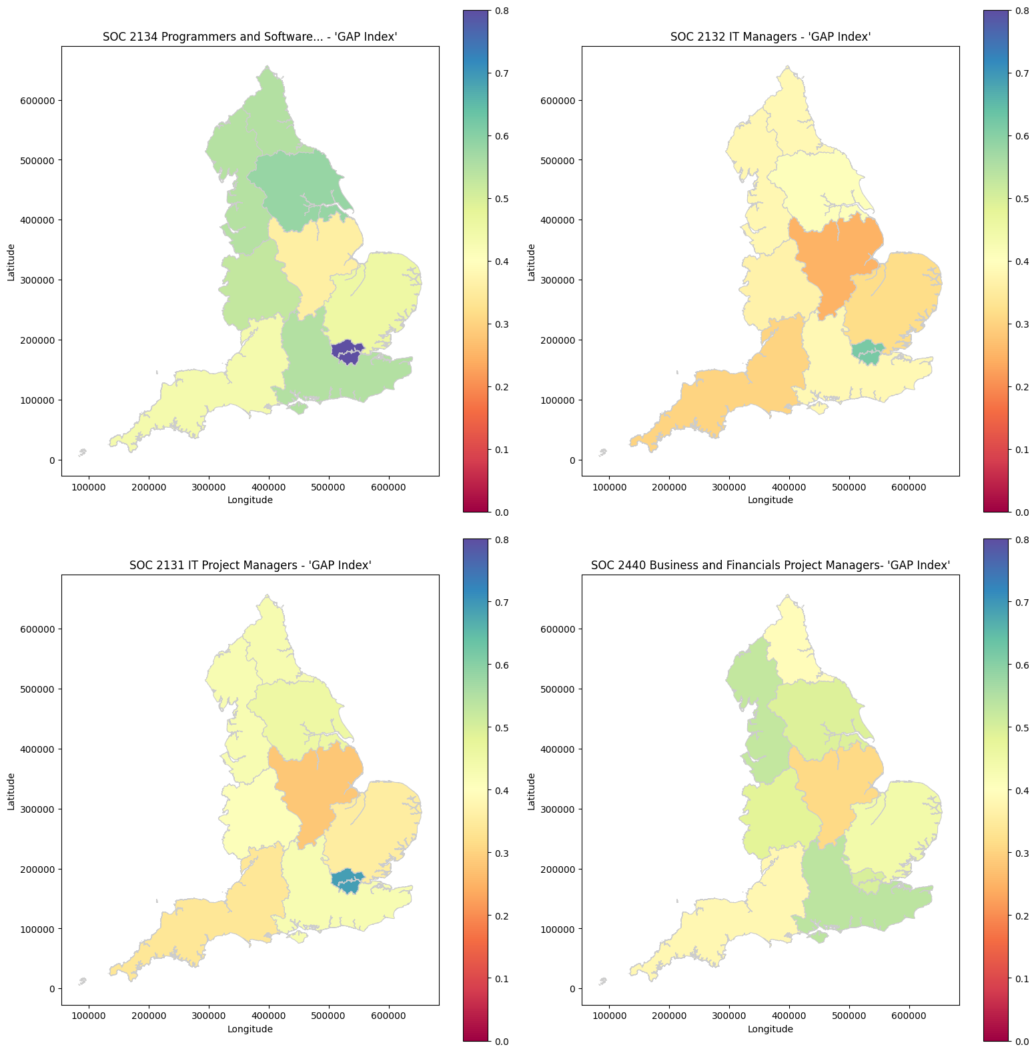
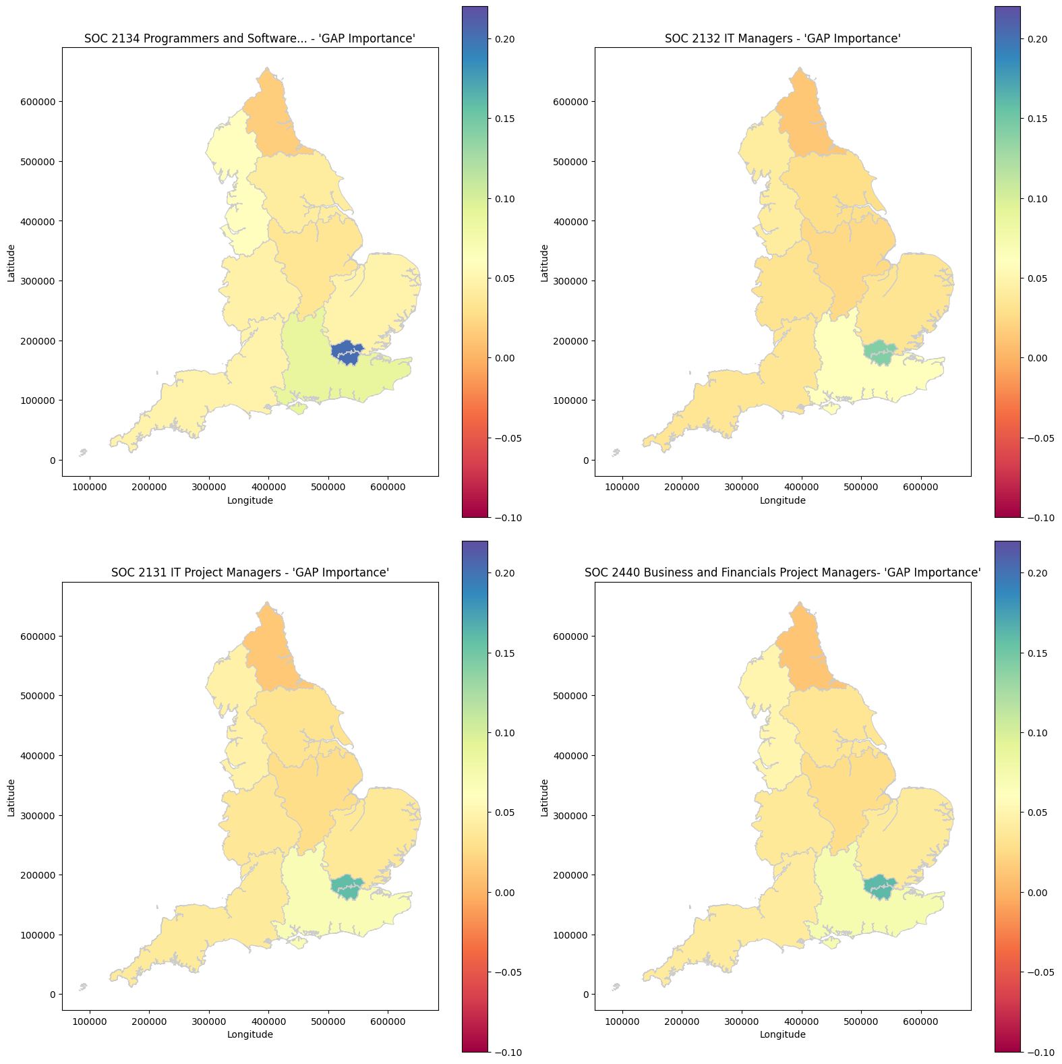
Gap Index – Selected SOC4
Gap Importance – Selected SOC4

Slide 20
Industry Analysis

Slide 21
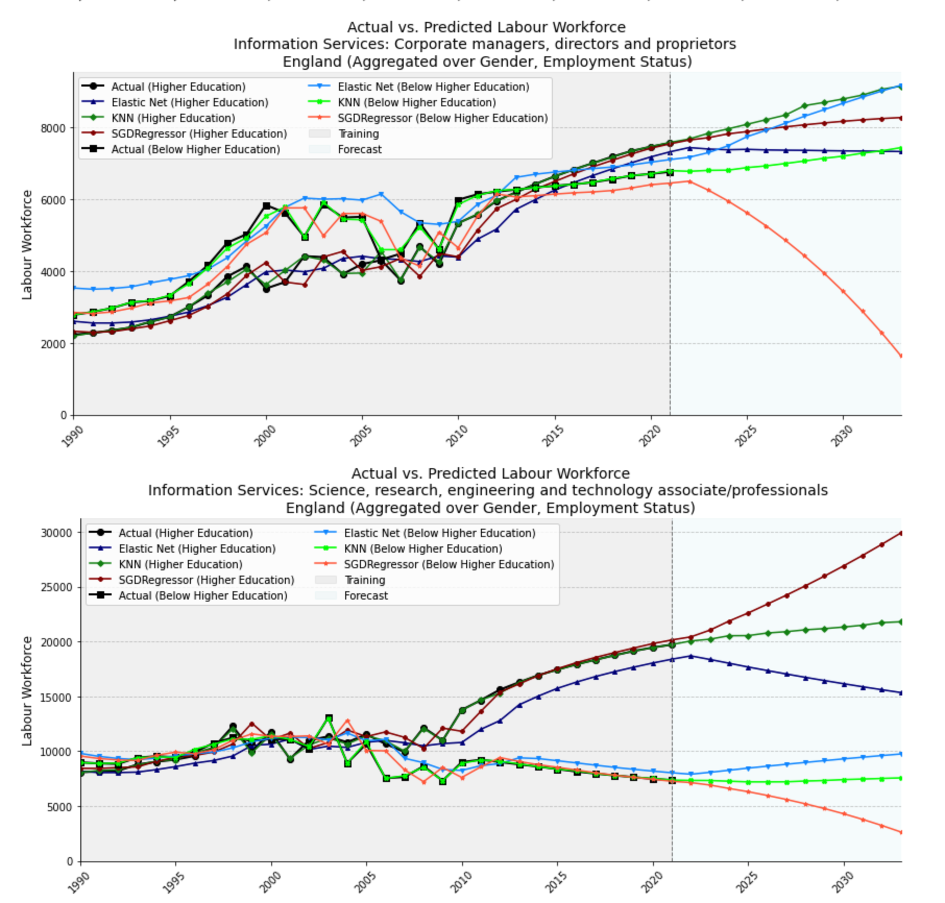
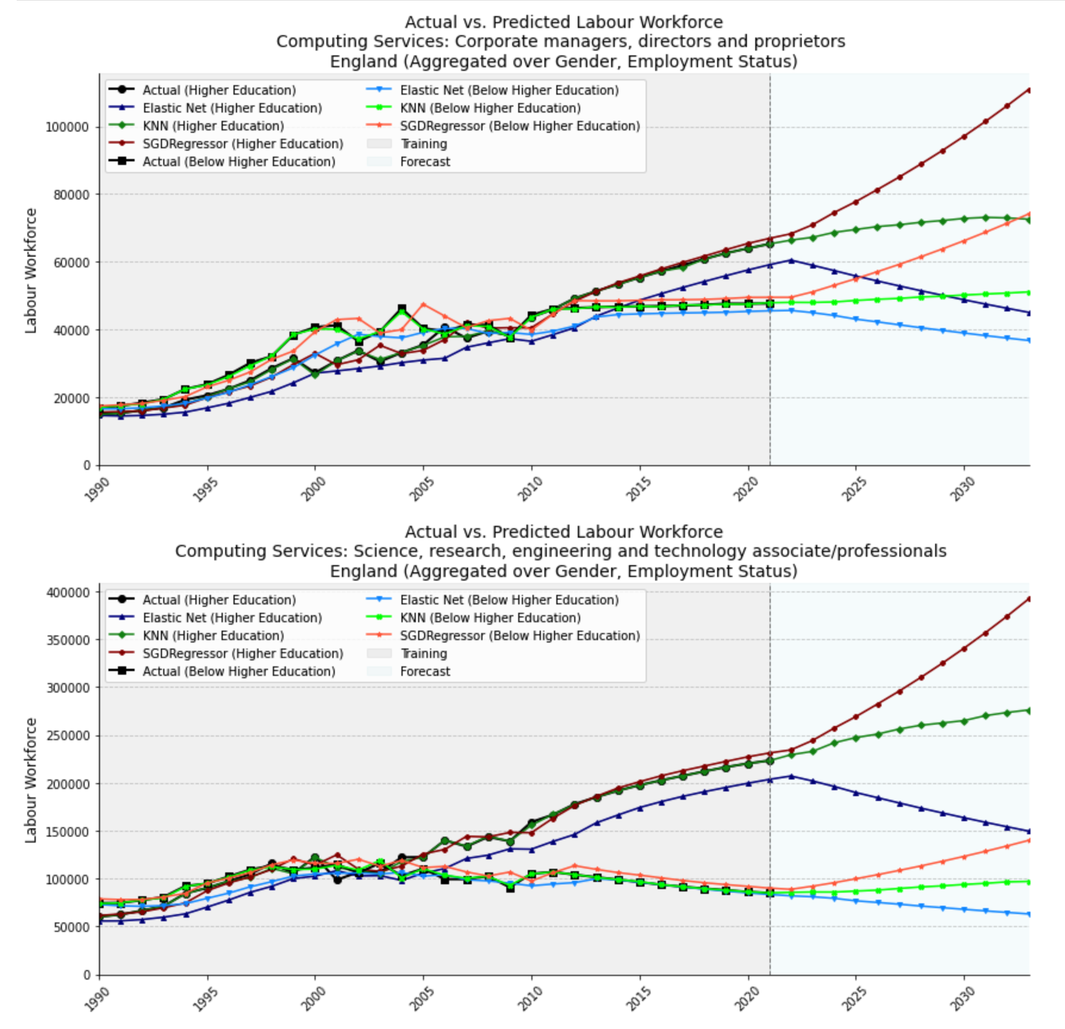
Industry Analysis: IT/Computing Services

Slide 22
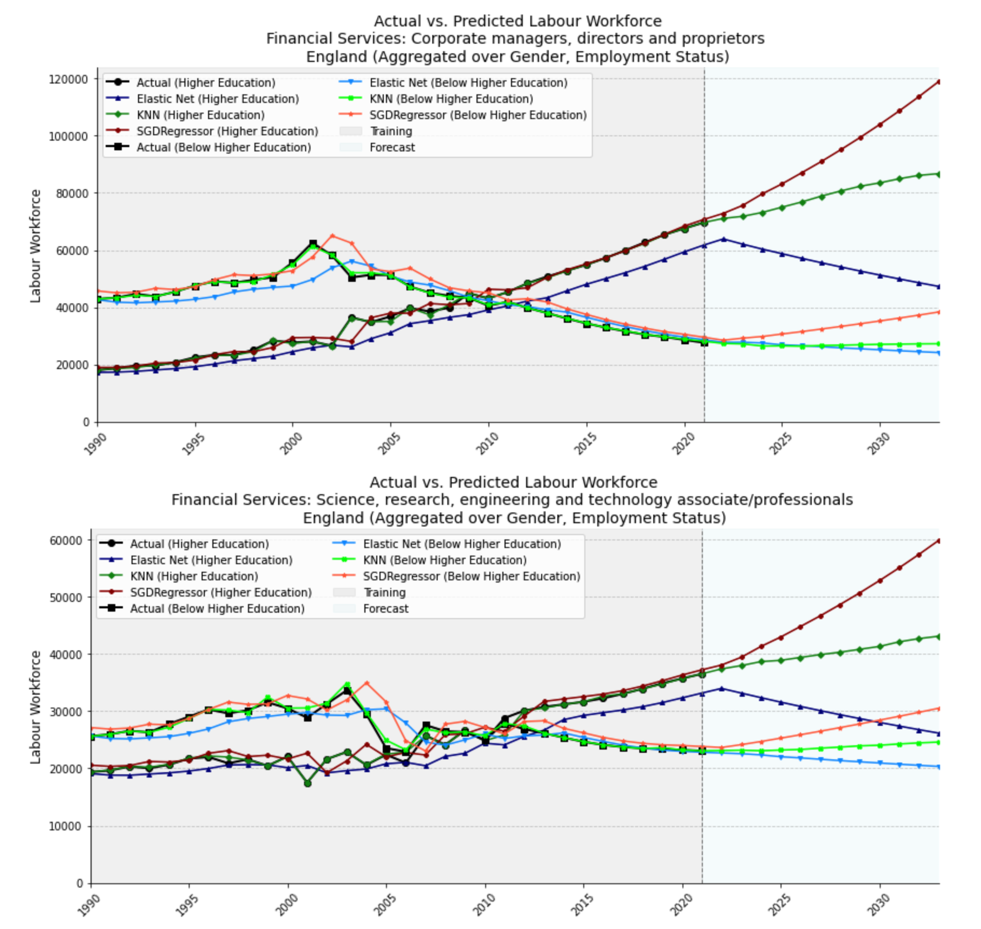
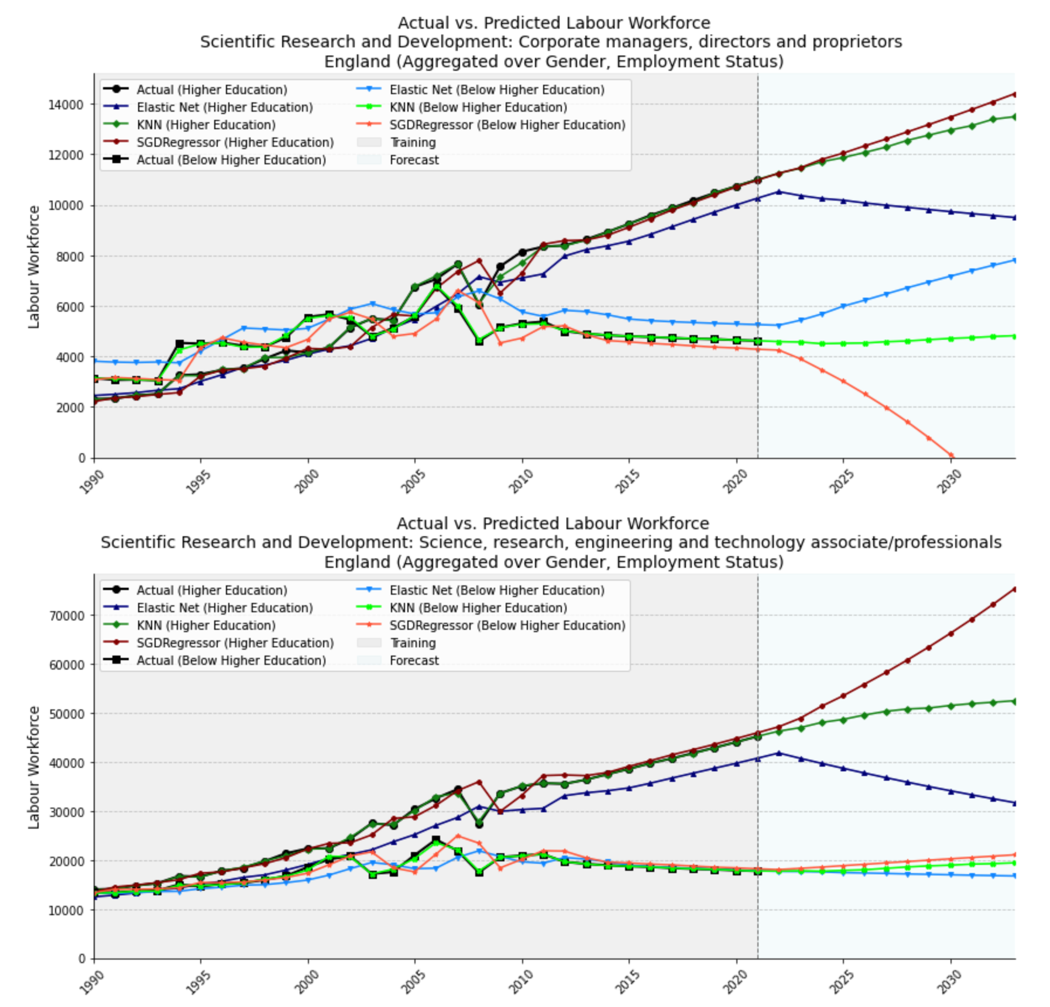
Industry Analysis: Finance and Research

Slide 23

Industry 2035 Key Takeaways:
Steady growth of analyzed markets regarding Higher Education
Software and Data related skills predicted to increase in demand
Soft skills shortage/requirement becoming more evident
Need for further education in several Tech stacks, including novel ones

Slide 24
IBM Recommendations

Slide 25

Recommendations to IBM - Platform
Challenge | Recommendation
Significant skills gap in soft skills (i.e., leadership, management, communication) | IBM Skills Build has a strong repository of non-technical skills (i.e., Design thinking, project management, etc.). The nature of soft skills is inherently social. We recommend introducing a social aspect to soft-skills focused courses through: Group-based projects Simulation based on real business problems Access to seminars and conferences Mentorship programs
Lack of employer investment in training | Reduced investments in on-the-job training for employees implies that employees’ skills may become obsolete or in-adequate with changing technology and business processes. We recommend focusing on: Generalization: Courses that focus on specific technologies should also incorporate core principles (i.e., course on C+ includes software engineering principles transferable across languages) Application: There is extensive educational resources on theory and technical knowledge areas. Where possible, learned should be encouraged to apply concepts through short and long form exercises (i.e., review a research paper and apply approach to a business problem)
Current platforms do not fully address the needs of employers and workforce | Employer needs: Skills training needs to closely align with the requirements of employers. We recommend ensuring IBM skills tracks (i.e., data analyst, cloud computing, etc.) meets those need by assessing the training against WorldSkills Occupational Standards (WSOS). WSOS provides “rubrics” by occupational role with the knowledge, skills, and capabilities that underpin the role. In addition, WordSkills also tests the quality of external training programmes and can support IBM in a review. Workforce needs: Learners are keenly interested in platforms that engage and support their learning. In order to increase engagement, we recommend exploring different formats for IBM courses (i.e., bootcamp styles, virtual classrooms, etc.) and incorporating user-friendly learning tools (i.e., memorization widgets, smart agents, etc.).
One size fits all approach in training platforms may not be the right fit for all learners | IBM Skills Build has a variety of IT and AI tracks, such as Cloud Computing and Data Science. However, these career tracks currently offer a very broad overview of the topics. As such, we recommend IBM tailor the content to different levels of expertise. For example, content could be separated into beginner, intermediate, and advanced levels or specific knowledge tracks could be created based on learner archetypes (experienced CS grad, career switcher, etc.). Advanced and specialist digital skills, over and beyond low-level AI, are of huge importance. For specialist and sector-specific skills, IBM could consider partnering with specific employers to co-create more advanced courses (i.e., advanced NLP methods).
1
2
3
4

Slide 26

Results of the Project:
Forecast of the Labour demand per SOC4 (Country) and SOC2 (Regions).
Importance Index: Identification of key SOC4 for IBM.
Regional Gap Index: Identification of the GAP per Region for selected SOC4.
Concurrent Skills Analysis: Scraped job postings based on positions relevant to IBM (Selected SOC4)
Forecast of Labour Market by 2035: Expected trend and market size based on given slice of the population.
Granular Forecasting Framework: Split by gender, occupation, qualification, industry, and region.
IBM Skills Build Recommendations: Insights based on current state of the platform supported by project outputs.

Slide 27

Learnt during the module
Structured Management
Adaptability in Data Selection
Efficient Task Distribution
Feedback Mechanism
Data Challenges
Methodological Flexibility

Slide 28
Q&A: Any questions?

Slide 29
THANKS!

Slide 30
References
Dickerson, A., Rossi, G., Bocock, L., Hilary, J. and Simcock, D. (2023). An analysis of the demand for skills in the labour market in 2035. Working Paper 3. Slough: NFER
Dickerson, A. and Rossi, G. (2024). An analysis of the demand for skills in the labour market in 2035: Revised tables and figures. Slough: NFER.
Dabhi, K., Crick, C., Douglas, J., McHugh, S., & Zatterin, G. et al. (2020). Understanding the UK AI Labour Market: 2020. Ipsos MORI. https://assets.publishing.service.gov.uk/media/60992b39d3bf7f2888d18f84/DCMS_and_Ipsos_MORI_Understanding_the_AI_Labour_Market_2020_Full_Report.pdf
DfE (2023). Labour market and skills projections: 2020 to 2035. https://www.gov.uk/government/publications/labour-market-and-skills-projections-2020-to-2035

Slide 31
ADDITIONAL MATERIALS

Slide 32
Regional GAP Index - Regional GAP Importance

Slide 33
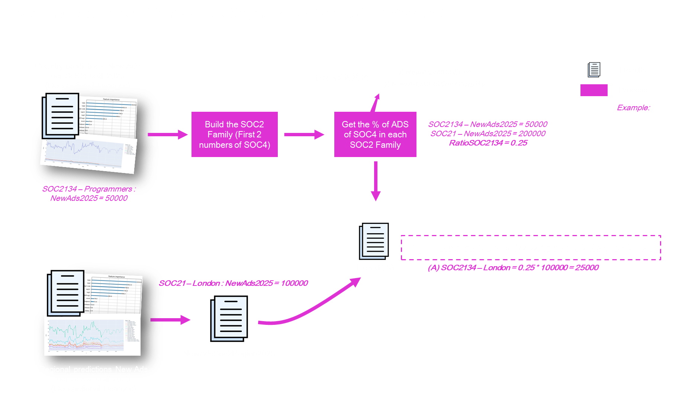

Slide 34
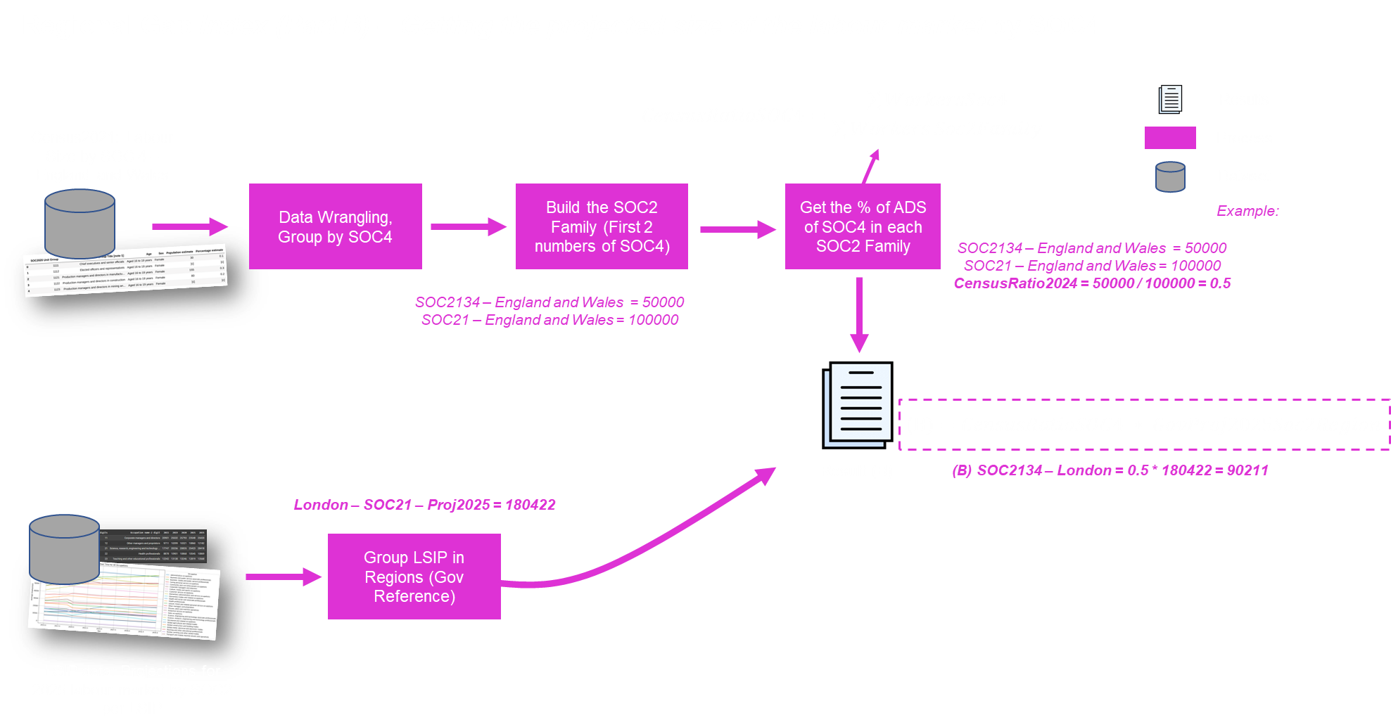

Slide 35


